Slide 1




PROJECT TITLE
ROBUST-RAG BOT: RETRIEVAL-AUGMENTED Generation IN VAN–BOT COOPERATIVE DELIVERY
Team Name: Dynamic
Anjana G Kumar
Sreejith P

Slide 2

Problem Statement
Goal 11 : Sustainable Cities and Communities

Slide 3


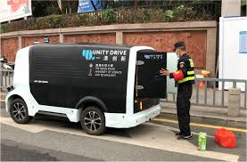
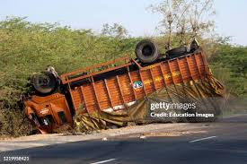
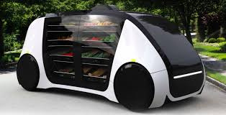
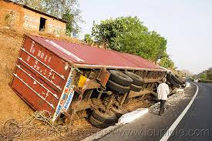

Background / Current Scenario
The tremendous and exponential increase in global online business has greatly intensified a phenomenon known as the "Last Mile Problem," a critical logistics bottleneck in which the last mile of shipping contributes over 53% to total shipping costs. However, conventional shipping is fast becoming unsustainable owing to a highly congested urban infrastructure, increasing fuel costs, and a dire human resource crunch. Additionally, a demand for quick and same-day deliveries poses a physical limitation and a environmental constraint with respect to human resources and fossil fuels, respectively. Thus, there exists an imperative logistics need that is currently unmet with regard to autonomous systems designed to operate in a complex urban infrastructure in order to reduce operational overheads.

Slide 4
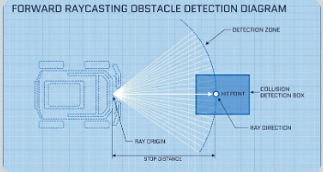
Your Proposed Solution
The Unity 3D engine, combined with the ML-Agents toolkit, hosts the proof-of-concept for Sim2Real autonomous delivery. The system uses an agent driven by the state-of-the-art policy gradient method, called Proximal Policy Optimization (PPO), for stable and efficient training. The agent was allowed to have Vector Observations (simulated GPS/Compass data) to perceive the relative position of the package and delivery van. With a very carefully designed reward function (penalizing time-wasting and collisions while incentivizing successful pickups and deliveries), in every iteration, the neural network optimizes its behavior. This gives the self-sustaining logistics unit the ability to make real-world decisions to carry out "Last Mile" deliveries efficiently, effectively bridging theoretical AI models with practical robotic application.

Slide 5
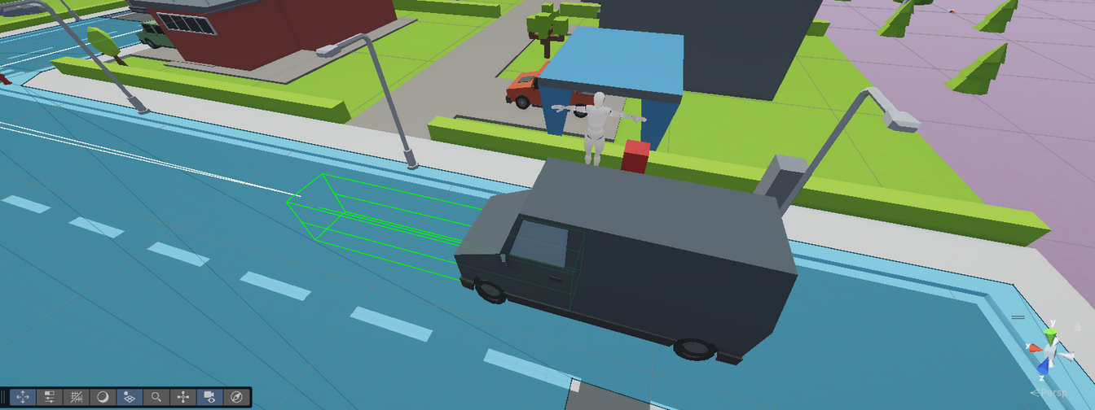
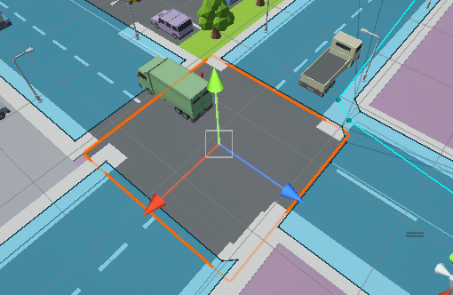
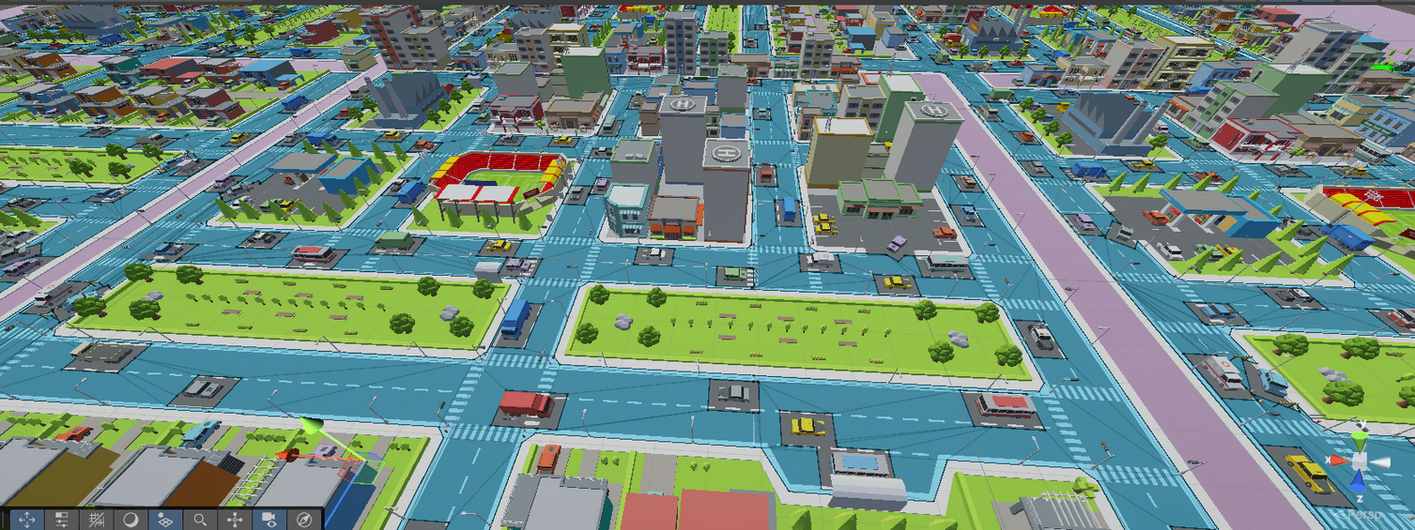
Your Proposed Solution

Slide 6
Innovation / Uniqueness
Unlike traditional autonomous navigation systems that follow predictable rule-based methodologies (such as A\* pathfinders), expensive pre-mapped environments are not required. This project differs significantly because, with Deep Reinforcement Learning, emergent intelligence is possible. The key difference here is the capacity of the autonomous agent to learn without human input or instructions. With the implementation of a Stochastic Training Environment, whereby the location of the package and the target locations are randomized, the common AI mistake of "overfitting," or memorization, is avoided. This allows the autonomous agent to create a comprehensive understanding of navigation and target tracking, hence providing better adaptability to unseen environments, as opposed to traditional autonomous navigation agents that tend to "follow lines" and are generally inflexible.

Slide 7
Impact & Benefits
Therefore, it can be concluded that the implementation of this autonomous technology within the context of urban landscape has the potential to create a transformative effect in terms of addressing the problem of increasing operation costs associated with the process of "Last Mile" delivery by up to 40%. This autonomous technology in terms of addressing the issue of the delivery process eliminates human labor costs, ensuring that it has the flexibility to reach its potential in terms of its utilization in the process of delivery by working 24/7. Therefore, it can be concluded that this technology, in terms of utilizing autonomous electric agents, ensures that the process of delivery becomes "Green" in terms of the concept of the "Green City." Moreover, this autonomous technology has the ability to democratize this process in terms of ensuring equivalent opportunity to both large and small businesses, while also providing human labor an opportunity to advance to a higher level.

Slide 8
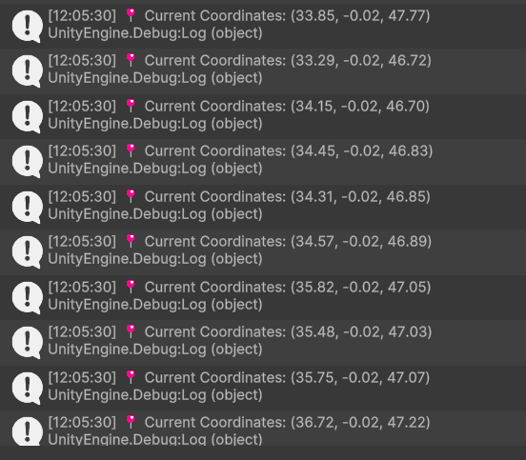
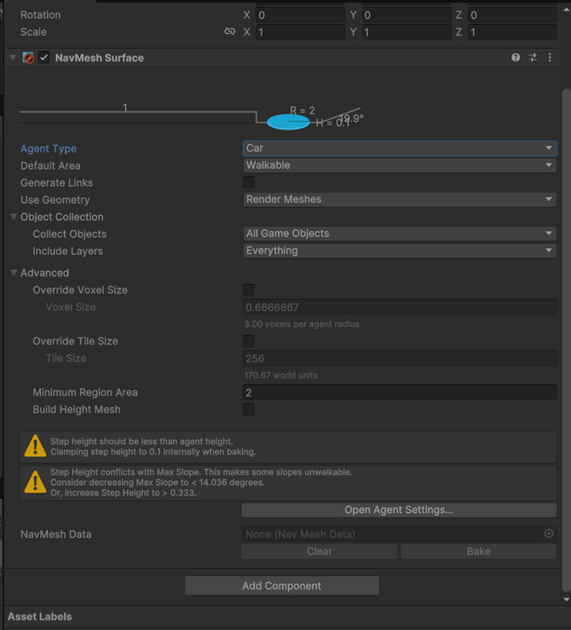
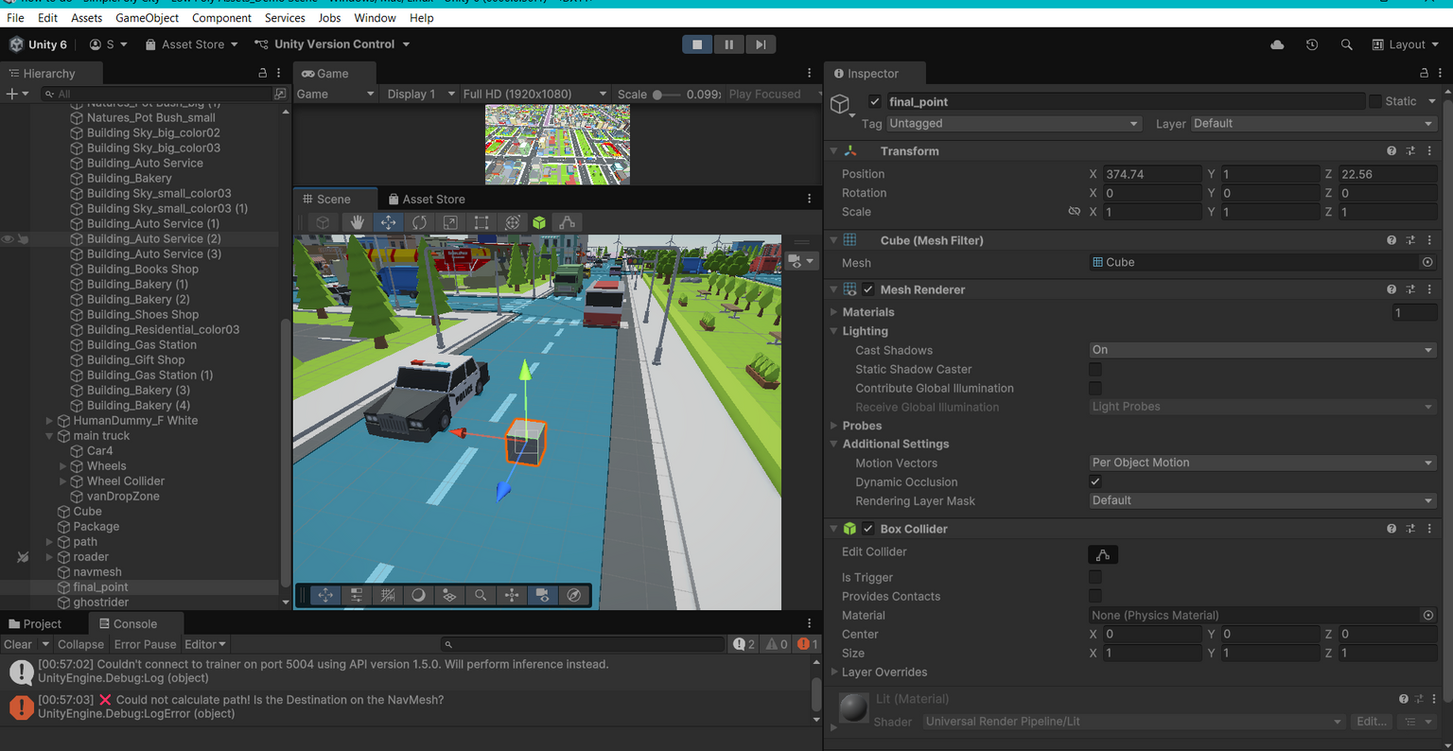
Impact & Benefits

Slide 9
Feasibility & Implementation
The feasibility of this project is underpinned by its utilization of established, open-source technologies—specifically the Unity Engine and Python-based ML-Agents toolkit—which allows for the development of complex AI behaviors on standard consumer-grade hardware without the need for expensive supercomputing clusters. By leveraging a simulation-first approach, the project eliminates the prohibitive costs and physical risks associated with hardware prototyping, such as robot maintenance and sensor damage. Furthermore, the modular nature of the neural network architecture ensures scalability; the agent's logic can be transferred from the simulation to physical microcontrollers (like NVIDIA Jetson or Raspberry Pi) using the lightweight ONNX format. This demonstrates a highly cost-effective and technically viable pathway for deploying autonomous solutions, validating the system's potential for real-world adoption with minimal financial barrier to entry.

Slide 10
Conclusion
In alignment with Goal 11: Sustainable Cities and Communities, this work addresses the pressing challenges of the urban Last Mile Problem, where escalating congestion, fuel dependency, labor shortages, and environmental constraints render conventional logistics increasingly unsustainable. By leveraging a Sim2Real autonomous delivery framework built using the Unity 3D engine and ML-Agents toolkit, the proposed system demonstrates a scalable and intelligent alternative to human-centric delivery models. Employing Proximal Policy Optimization (PPO), the agent learns robust navigation and decision-making behaviors through carefully engineered vector observations and reward shaping, enabling efficient coordination between delivery bots and vans in complex urban environments. The results highlight the feasibility of autonomous, self-sustaining logistics units capable of reducing operational overheads, minimizing carbon emissions, and supporting rapid delivery demands without exacerbating urban strain. Ultimately, this approach bridges the gap between theoretical reinforcement learning models and real-world robotic deployment, offering a viable pathway toward resilient, sustainable, and future-ready urban delivery ecosystems.

Slide 11
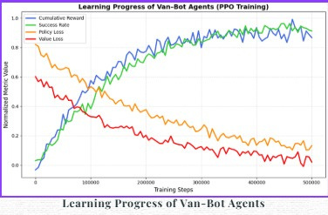
Conclusion

